Slide 1
Implementing the National HIV/AIDS Strategy through the Federal Action Plan
USCA 2016 – September 16, 2016
Harold Phillips, MRP Director
Office of Domestic & Global HIV Training & Capacity Development Programs
HRSA HIV/AIDS Bureau

Slide 2
HRSA & Implementation Activities on:
Integrated planning (CDC/HRSA)
Data integration & Housing Services (HUD/HRSA)
Addressing Health Disparities
PrEP Implementation (OHAIDP, CDC, HRSA, SAMHSA)
NHAS Implementation through 2020 (ALL)

Slide 3
NHAS 2020 Implementation HRSA/HAB Priorities
NHAS 2020/PEPFAR 3.0 - Maximize HRSA HAB expertise and resources to operationalize NHAS 2020 and PEPFAR 3.0
Leadership - Enhance and lead national and international HIV care and treatment through evidence-informed innovations, policy development, health workforce development, and program implementation
Partnerships - Enhance and develop strategic domestic and international partnerships internally and externally
Integration - Integrate HIV prevention, care, and treatment in an evolving healthcare environment
Data Utilization - Use data from program reporting systems, surveillance, modeling, and other programs, as well as results from evaluation and special projects efforts to target, prioritize, and improve policies, programs, and service delivery
Operations - Strengthen HAB administrative and programmatic processes through Bureau-wide knowledge management, innovation, and collaboration
Notes:
NHAS 2020/PEPFAR 3.0: Maximize HRSA HAB expertise and resources to operationalize NHAS 2020 and PEPFAR 3.0. This includes utilizing our RWHAP and PEPFAR legislations, resources, staff and recipient expertise, national leadership, and partnerships to achieve the goals of NHAS 2020 and PEPAR 3.0.
Examples of focus areas/activities:
• HRSA and HAB level PrEP Workgroups
• RWHAP Part A HIV Continuum of Care Learning Collaborative Initiative
• Global program work in health workforce development and health systems strengthening in the four Fragile States
• Continuous engagement of HAB staff expertise for the development and implementation of NHAS and PEPFAR activities
Leadership: Enhance and lead national and international HIV care and treatment through evidence-informed innovations, policy development, health workforce development, and program implementation.
Examples of focus areas/activities:
• Presenting at the USCA and other high profile meetings to disseminate HRSA policies, HIV care and treatment information and best practices
• Convening the Ryan White HIV/AIDS Program Consultation on Clinical Quality Measurement of Retention in HIV Medical Care
• Staff engagement with opportunities for leadership through workgroups, special projects, Cooperative Agreement and/or contract lead, etc. as well as HRSA leadership training
• Focusing on leadership development by and for people living with HIV
• Development of the National HIV Curriculum with the AETC National Resource and Coordination Center
• Dissemination of best practices through the SPNS Dissemination of Evidence Informed Interventions to Improve Health Outcomes along the HIV Care Continuum Initiative (DEII)
• Developing an HIV health care workforce strategy
• Resilient and Responsive Health Systems in fragile countries
Partnerships: Enhance and develop strategic domestic and international partnerships internally and externally. This includes promoting better collaboration across Divisions, Bureaus/Offices, and HHS OpDivs and other federal agencies in design and implementation of data utilization, programmatic initiatives, communications, and policy development to support service integration and to utilize HRSA, HAB, and partner resources most effectively.
Examples of focus areas/activities:
• Strategic partnerships development work focusing on CDC,SAMSHA, CMS, and HOPWA
• Internal HRSA strategic partnership work with BPHC on service delivery; BHW for workforce development; MCHB for adolescent health and maternal and child health
• Overall Hepatitis C focus and SMAIF Hepatitis C initiative working with BPHC, CDC, and OHAIDP
Integration: Integrate HIV prevention, care, and treatment in an evolving healthcare environment. This includes maximizing opportunities afforded by the healthcare system for preventing infections, increasing access to quality HIV care, and reducing HIV-related health disparities.
Examples of focus areas/activities:
• Quality Management Programs and Quality Measures in the RWHAP and Medicaid
• SPNS Health Information Technology
• Integrated HIV Prevention and Care Plans, including the Statewide Coordinated Statement of Need
• Leveraging opportunities offered by health delivery system reform
Data Utilization: Use data from program reporting systems, surveillance, modeling, and other programs, as well as results from evaluation and special projects efforts to target, prioritize, and improve policies, programs, and service delivery.
Examples of focus areas/activities:
• Continue to document outcomes of the RWHAP and delineate health disparities
• Provide technical assistance to grantees and staff to enhance their capacity
• Focus programmatic, cooperative agreements, and special study investment on specific population focus based on data, e.g. youth, black men who have sex with men, transgender individuals to improve health outcomes
• SPNS Health Information Technology investments
Operations: Strengthen HAB administrative and programmatic processes through Bureau-wide knowledge management, innovation, and collaboration. This includes supporting excellence in HIV care and treatment service delivery and programs by ensuring efficient business and scientific administration, implementing effective communication and policies, and enhancing the skills of current staff.
Examples of focus areas/activities:
• Streamline and improve the site visit, non-site visit, and conference planning processes for travel
• Enhancing communication mechanisms for external and internal stakeholder with an emphasis on staff communications
• Improving SharePoint functionality for workflow processes and information management
• Improving EHB functionality for workflow, dashboard utilization, and reports

Slide 4
Integrated Planning

Slide 5
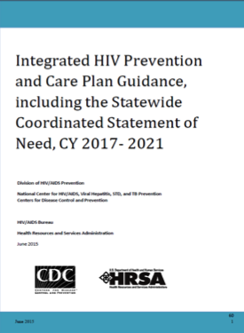
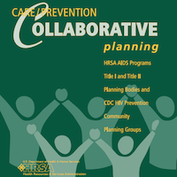
Integrated Planning
2003
2000-2014
2014
Notes:
We have been at this for quite a while.

Slide 6
What is Integrated Planning?
Integrated HIV planning is the process by which HIV care and prevention planning groups work together to:
Review information about the HIV epidemic in the jurisdiction
Assess needs and service utilization data to inform decisions
Provide recommendations and allocate resources for HIV prevention and care services to address the HIV epidemic
Notes:
The Integrated HIV Prevention and Care Plan reflects the community’s vision and values regarding how best to deliver HIV prevention and care services
The Integrated HIV Prevention and Care Plan is a living document that serves as a jurisdictional HIV/AIDS strategy, or roadmap, for CDC and HRSA grant recipients

Slide 7
Why Do Integrated Planning?
Streamline communication, coordination, and implementation of needed HIV prevention and care services to improve health outcomes along each stage of the HIV Care Continuum
Reduce reporting burden for federal recipients
Engage a broader group of stakeholders in jurisdictional HIV prevention and care planning
Maximize federal, state, and local HIV prevention and care investments

Slide 8
National Policy Initiatives Supporting Integrated Planning
CDC/HRSA Advisory Committee on HIV, Viral Hepatitis and STD Prevention and Treatment (2002)
CDC’s Advancing HIV Prevention (AHP) Initiative (2003)
CDC’s High-Impact HIV Prevention Approach (2011)
National HIV/AIDS Strategy (2015, 2020)
HHS and OMB’s focus on streamlining and reducing reporting burden for federal programs and recipients

Slide 9
INTEGRATED HIV/AIDS PLANNING Technical Assistance Center
3-year
project
Supports
Ryan White
HIV/AIDS
Program Parts A & B
Will conduct
virtual and in-person technical assistance activities
beginning July 1, 2016
grant recipients and their planning bodies

Slide 10
Data Integration

Slide 11
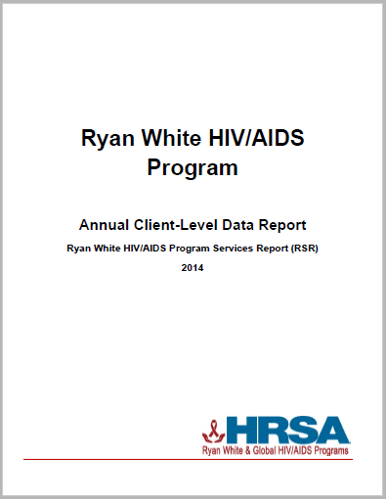
Using Client-level Data to Measure Outcomes
National focus on data
Program monitoring and evaluation
NHAS 2020
5 years of data available 2010-2014
Expands the availability of and access to Ryan White HIV/AIDS Program client-level information
First annual publication of national RWHAP client-level data collected through the RSR
EMA & TGA data reports look at all data within an EMA/TGA (Includes RWHAP Parts A-D funded recipients)

Slide 12
Coordinating Systems
Why Should Housing and Health
Work Together?

Slide 13
Importance of Collaborative Approach to Housing-Health
Studies consistently find homelessness and housing instability are directly linked to higher viral loads and failure to achieve or sustain viral suppression, even after controlling other factors known to impact treatment effectiveness such as substance use and mental health needs.
Aidala,A.A, et al. (2012).Housing status and the health of people living with HIV/ AIDS: A systematic review. Presented at the XIX International AIDS Conference, Washington, D.C., July 2012; Leaver C.A. et al. (2007). The effects of housing status on health-related outcomes in people living with HIV:A systematic review of the literature. AIDS and Behavior, 11(6)/Supp 2: S85-S100.

Slide 14
Why Housing? National HIV/AIDS Strategy
Housing Measure
Federal Action Plan
Addressing HIV Care and Housing Coordination through Data Integration to Improve Health Outcomes along the HIV Care Continuum (HRSA)
Improving the ability of HUD-funded "Continuums of Care" to identify homeless persons living with HIV and link them to housing assistance, medical care, and other services (HUD)
Addressing the intersection of HIV and IPV, identify models of improved service integration among HIV housing providers and providers of services for persons experiencing sexual assault, domestic violence, dating violence, and stalking (HUD)
Indicator 7
Reduce percentage of persons in HIV medical care who are homeless to < 5 percent from a baseline 7.4 percent
Progress
The rate of homelessness increased to 8.3% in 2012

Slide 15
Why Housing? Summary of Research Data
For persons who lack a safe, stable place to live, housing assistance is a proven, cost-effective health care intervention.
Stable housing has a direct, independent, and powerful impact on HIV incidence, health outcomes, and health disparities.
Housing status is a more significant predictor of health care access and HIV outcomes than individual characteristics, behavioral health issues or access to other services.
HIV CARE CONTINUUM The Connection Between Housing And Improved Outcomes Along The HIV Care Continuum (2013).

Slide 16
Housing Impacts on the HIV Care Continuum
Compared to stably housed persons, persons who are homeless or unstably housed:
Are more likely to become HIV infected
Are more likely to be diagnosed late, after infection has progressed to HIV
Are more likely to delay entry into HIV care
Experience higher rates of discontinuous health care
Are less likely to be prescribed Antiretroviral (ARV) treatment
Are less likely to achieve sustained viral suppression
Have worse health outcomes, with greater reliance on emergency and inpatient care
Experience higher rates of HIV-related mortality.
HIV CARE CONTINUUM The Connection Between Housing And Improved Outcomes Along The HIV Care Continuum (2013).

Slide 17
Ryan White HIV/AIDS Program Why Housing Support?
Over 16% of RWHAP clients have temporary or unstable housing situations
Populations identified as high priority in National HIV/AIDS Strategy (NHAS) experience highest rates of unstable housing (youth, injection drug users, men having sex with men (MSM) injecting drugs, transgender persons)
Unstably housed clients had lowest level of medical retention in all sub-analysis
Clients with unstable housing also have among the lowest rates of viral load suppression of any sub-group
Ryan White HIV/AIDS Program Annual Client-Level Data Report Ryan White HIV/AIDS Program Services Report (RSR)

Slide 18
Ryan White Services Report, 2011-2014 Housing Status For Clients Served
Housing status is unknown or missing for 90,883 clients in 2010, 68,332 clients in 2011, 50,073 in 2012, and 38,698 in 2013.
Notes:
Housing status is required for clients who received outpatient ambulatory medical care, medical case management, non-medical case management, or housing services.

Slide 19
HIV, Homelessness, & Suppression
2014 Ryan White Services Report Data:
Viral Suppression by Housing Status
Viral suppression: had at least one OAMC visit, at least one viral load count, and last viral load test <200
Notes:
Similarly for this subset of the RWHAP client population that receives Outpatient/Ambulatory Medical care, viral suppression declines slightly as housing stability declines.

Slide 20
How Can Ryan White HIV/AIDS Program Recipients and Planners Better Support Housing?
Examples of better coordination may include some of the following:
Inclusion of housing services in planning processes and procurement
Focus on housing for needs assessment studies
Co-located housing and care services
Targeted adherence programs for PLWH experiencing unstable housing
Enhanced strategic relationships with housing providers/experts
Inclusion of a housing indicator as a risk for non-adherence and/or medical retention
Assessment of housing status as part of a care plan
Resource commitment as appropriate

Slide 21
Notes:
Cascade AIDS Project (Portland, OR)
Kansas City Health Department (Kansas City, MO)
Hartford Department of Health and Human Services (Hartford, CT)*
Palm Beach County Department of Community Services, (Palm Beach, FL)*
Gregory House (Honolulu, HI)*

Slide 22
Health Information Technology (HIT) Capacity Building for Monitoring and Improving Health Outcomes along the HIV Care Continuum
Massachusetts Department of Public Health, Boston, MA
Health Research, Inc., Albany, NY
Virginia Department of Health, Richmond, VA
City of Patterson, Paterson, NJ

Slide 23
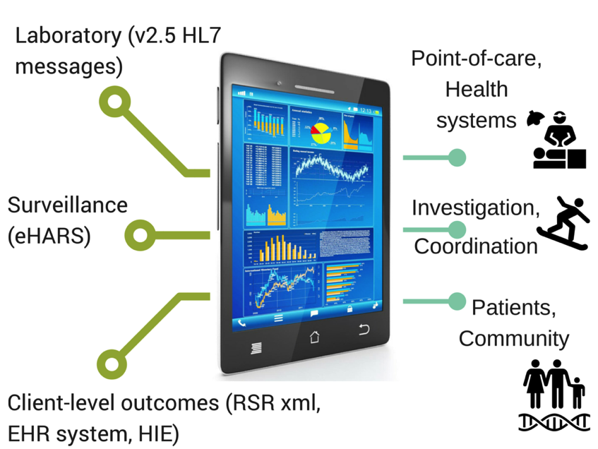
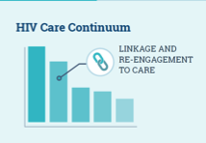

Slide 24
Addressing Health Disparities

Slide 25
Ryan White HIV/AIDS Program Clients (non-ADAP), by Race/Ethnicity, 2014—United States and 3 Territories
* Hispanics/Latinos can be of any race.
Notes:
Nearly three-quarters of RWHAP clients are from racial/ethnic minority populations. In 2014, of the 507,562 clients with reported race/ethnicity information, 47.2% self-identified as black/African American, 22.2% Hispanic/Latino, and less than 2% each American Indian/Alaska Native, Asian, Native Hawaiian/Pacific Islander, and persons of multiple races. Whites accounted for 27.0% of clients. The percentage distribution has remained consistent since 2010.
Hispanics/Latinos can be of any race.
In 2014, 64.2% of the 473,483 RWHAP clients with income information were living at or below 100% of the federal poverty level (FPL), a combined total of 76.3% of clients were living ≤138% FPL (the qualification level for Medicaid eligibility under the Patient Protection and Affordable Care Act).

Slide 26
Viral Suppression, RSR 2010-2014
Viral suppression: ≥ 1 OAMC visit during the calendar year and had ≥1 viral load reported whose last viral load was <200 copies/mL.
Source: HRSA, HAB, Annual Client-Level Data Report, Ryan White Services Report, 2014
Notes:
Rates of viral suppression are going up among clients who receive medical care in the RWHAP. There is still room for improvement but we’re going in the right direction…

Slide 27
Viral Suppression by Race/Ethnicity, RSR 2010-2014
Viral suppression: ≥ 1 OAMC visit during the calendar year and had ≥1 viral load reported whose last viral load was <200 copies/mL.
Source: HRSA, HIV/AIDS Bureau, Annual Client-Level Data Report, Ryan White Services Report, 2014
Notes:
Looking at the rates viral suppression by race/ethnicity…
The scale for viral suppression is from 60% to 90%
Viral suppression lowest in Blacks with Asians having the highest rates of suppression.

Slide 28
Viral Suppression among Young, Black/African American MSM (YBMSM) Aged 13–24 Years Served by the Ryan White HIV/AIDS Program (non-ADAP), 2014—United States and 3 Territories
≥5 percentage points lower than YBMSM overall
Note: N represents the total number of clients in the specific subpopulation.
Viral suppression: ≥ 1 outpatient ambulatory medical care visit during the calendar year and ≥1 viral load reported, with the last viral load result <200 copies/mL.

Slide 29
Viral Suppression Among NHAS 2020 Key Populations Served by the Ryan White HIV/AIDS Program (non-ADAP), 2010 and 2014—United States and 3 Territories
Viral suppression: ≥ 1 outpatient ambulatory medical care visit during the calendar year and ≥1 viral load reported, with the last viral load result <200 copies/mL.

Slide 30
A Few HRSA Initiatives to Address Health Disparities
Center for Engaging Black MSM Across the Care Continuum (CEBACC)
Health Literacy Project
PLWH Leadership Project
Building Care/Prevention Capacity: HIV Care Continuum in Southern Metro Areas
Improving Access to Care Using Community Health Workers to Improve Linkage and Retention in HIV Care
Increase Access to Health Care Coverage and Improve Health Literacy
Integrated HIV Planning
Leadership Training for People of Color Living with HIV
Jurisdictional Approach to Curing Hepatitis C among HIV/HCV Co-infected People of Color

Slide 31
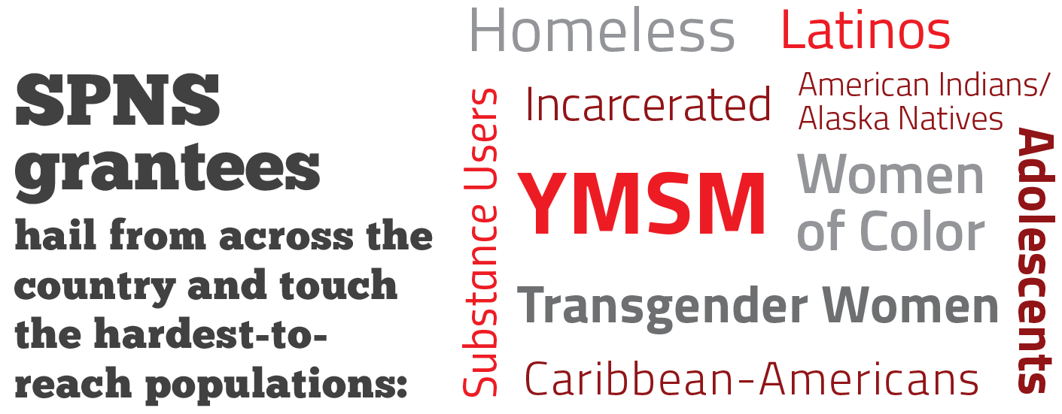
SPNS
Grantees
are located across the country and work with the hardest-to-
-reach populations:
Notes:
And the program focuses on those populations hardest hit by the HIV epidemic.

Slide 32
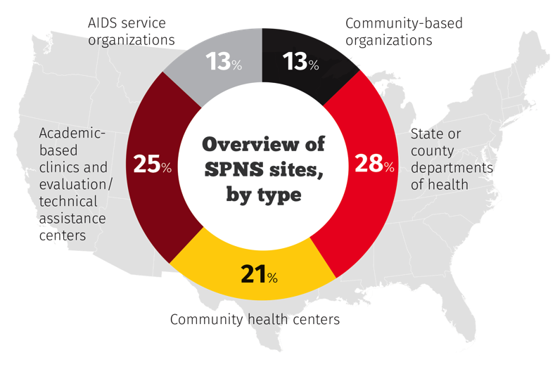
Types of SPNS Recipients 70 Current SPNS Sites
SPNS recipients represent public and private nonprofit organizations
that serve people living with HIV/AIDS.
Notes:
Eight SPNS initiatives have 70 SPNS sites located across the country.

Slide 33
AETC Programs: Multi-Faceted to meet needs at multiple levels
National Programs
Provides a National Educational platform with standard Curricula, Resources and Evaluation. RIGHT THING
Regional Programs
Locally based, tailored trainings and educational programs to address immediate training needs. RIGHT PLACE
Training Programs
Training NP/PA practitioners in HIV to care for PLWH in the changing healthcare landscape. RIGHT TIME
Notes:
The programs within the AETC Umbrella – the National programs, the regional AETCs and the NP/PA training program- all fit together to provide a comprehensive multi-faceted approach to the education and training needs in the United States.
The National Programs – provide a standard for the country – in terms of resources through the NCRC and a standard National HIV curricula which is scheduled to be released January, 2017. The NCCC provides expert responses to complex clinical questions through the HIV Warmlines. Together, these AETCs provide a national standard of the RIGHT THING.
The regional AETC programs complete a thorough needs assessment of their region to understand the training needs of their area, then provide locally tailored trainings and educational programs. The Regional AETCs have in depth networks and partnerships that make responding to crises like the outbreak in Indiana, possible. They have boots on the ground and are able to respond in the RIGHT TIME.
And the NP/PA training programs are shaping providers for today and for tomorrow as they integrate HIV into the general NP/PA curricula across the country as well as provide specialized training to meet the healthcare needs of PLWH – i.e. putting providers in the RIGHT PLACE.

Slide 34
PrEP

Slide 35
PrEP
PrEP Federal Guidelines
Federal guidelines for health care providers categorize those at substantial risk by mode of transmission for individuals who do not use condoms, and/or people who inject drugs. Refer to the PrEP guidelines for the detailed information.
http://www.cdc.gov/hiv/pdf/guidelines/PrEPguidelines2014.pdf

Slide 36
Developmental Indicators
PrEP use
HIV stigma
HIV among transgender persons

Slide 37
HRSA PrEP Implementation Activities
Clinical Consultation on PrEP
AETC Training (AETC Training of Clinicians on assessment, risk, payment of PrEP) with focus on integrating primary care and HIV care
Curriculum Development
HRSA Policy on PrEP and RWHAP Coverage as Part of Comprehensive Strategy

Slide 38
HRSA PrEP Implementation Activities
National Clinician Consultation Center (NCCC)
PrEP advice for clinicians, from determining when prescribing PrEP is appropriate to understanding follow-up tests.
(855) 448-7737 or (855) HIV-PrEP
Monday – Friday, 11 a.m. – 6 p.m. EST
NCCC is supported by HRSA and CDC

Slide 39
How RWHAP Can Support PrEP June 23, 2016 Program Letter
Confirms HRSA HIV/AIDS Bureau support of RWHAP recipients’ exploring ways to use expertise and infrastructure to support PrEP
RWHAP cannot be used for PrEP medications or medical services for HIV-negative clients at substantial risk for HIV
Building PrEP services or programs on existing RWHAP systems, services, programs, personnel, and expertise (leveraging what has been built over the past 25 years)
Using components of a few service categories specifically related to: HIV testing and referral; Psychosocial support for affected family members; Risk reduction education for partners of people living with HIV
AETCs: Training to Primary Care Providers on PrEP – CDC-Funded PrEPline

Slide 40
NHAS 2020
Notes:
Data integration (HUD, HRSA) (Amy Lansky, Rita Flegel, Harold Phillips)
· HRSA and HUD are working together to improve health outcomes along the HIV care continuum using the electronic integration of housing and HIV care data systems. Could you tell us a little more about this project and what you have achieved so far?
· What challenges did you encounter working in different agencies? How did you address them?
· Could you describe the working relationship and communication pathways between/across your agencies? How did you leverage the resources, including the expertise, of each agency to achieve your goal?
· On a practical level, what difference does this make for the clients that you serve and their ability to stay healthy and virally suppressed?
· How does this issue/action item fit into your agency’s larger role in moving the National HIV/AIDS Strategy forward?

Slide 41
Federal Action Plan
Reducing New Infections:
HRSA and CDC will develop and deliver TA, trainings, and information to HRSA programs on PrEP and PEP implementations strategies.
Improving Access to Care & Health Outcomes:
HRSA will provide TA on Data to Care by developing a learning collaborative across Ryan White jurisdictions to share models for addressing gaps along the care continuum.
OPA, CDC, HRSA will provide trainings for HHS award recipients to incorporate family planning as part of comprehensive HIV, mental health, substance use treatment delivery.

Slide 42
Federal Action Plan
Reducing Disparities:
HRSA and CDC will promote development of public leadership skills by including PLHIV in integrated prevention/care planning.
Achieving Greater Coordination:
HRSA and HUD will identify models for integrating housing and HIV care data systems to enhance coordination of service delivery.
HRSA will develop tools to help award recipients measure progress toward performance goals.

Slide 43
Contact Information
Harold J. Phillips, MRP HRSA HIV/AIDS Bureau
HPhillips@hrsa.gov

