Slide 1
The National HIV/AIDS Strategy: Reaching Key Populations
USCA 2016 – September 15, 2016
Amy Lansky, PhD, MPH
Director, Office of National AIDS Policy of the White House
Domestic Policy Council
Antigone Dempsey, MEd
Division Director, Division of Policy and Data, HIV/AIDS Bureau
Notes:
This panel discussion will examine efforts underway to improve HIV outcomes for key populations served by HRSA’s Ryan White HIV/AIDS Program, in pursuit of the goals of the National HIV/AIDS Strategy for the United States: 2020 (NHAS 2020). The discussion will be guided by a review of NHAS 2020 indicators and various interventions and coordination activities targeting, for example, Black MSM, transgender individuals, youth, etc.

Slide 2
What We Will Cover
3:00-3:20 pm Overview of NHAS 2020
Amy Lansky
3:20-3:40 pm NHAS 2020 and RWHAP
Antigone Dempsey
3:40-4:30 NHAS Listening Session

Slide 3
The United States will become a place where new HIV infections are rare, and when they do occur,
every person, regardless of age, gender, race/ethnicity, sexual orientation,
gender identity, or socio-economic circumstance
will have unfettered access
to high-quality, life-extending care, free from stigma and discrimination.

Slide 4
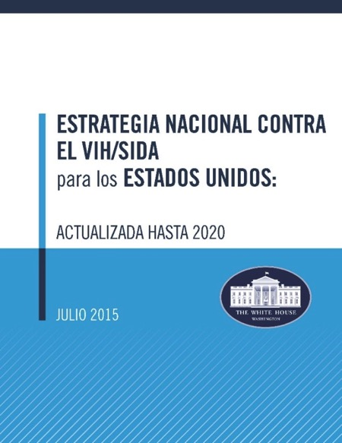
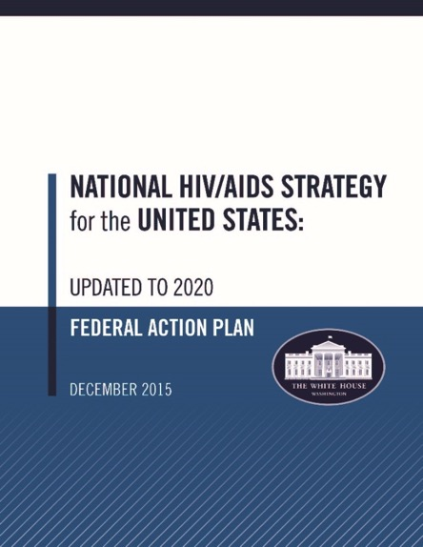
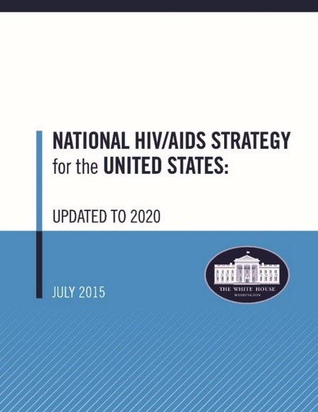
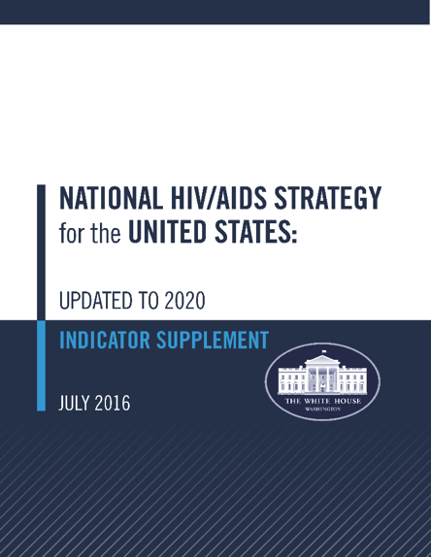
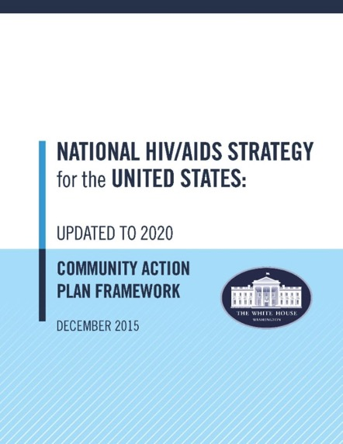

Slide 7
What’s New? What’s Different?
Harnessing the benefits of the Affordable Care Act
Expanded coverage options
HIV as a preexisting condition: no longer a barrier
Incorporating tremendous scientific progress
PrEP
Testing technologies
Granular hotspot surveillance
Lessons and progress from the 2010 Strategy
Interagency collaborations
Working groups
Funding allocation
Source: Brooks DM, National HIV/AIDS Strategy for the United States: Updated to 2020. Presentation, July 2015.

Slide 8
Established by Executive Order
The Update has incorporated the recommendations on:
HIV and Violence Against Women and Girls
HIV Continuum of Care Initiative
Implementing the National HIV/AIDS Strategy for the United States for 2015-2020
Within 100 days of July 30, 2015, each lead agency shall submit the agency's action plan for implementing the Updated Strategy

Slide 9
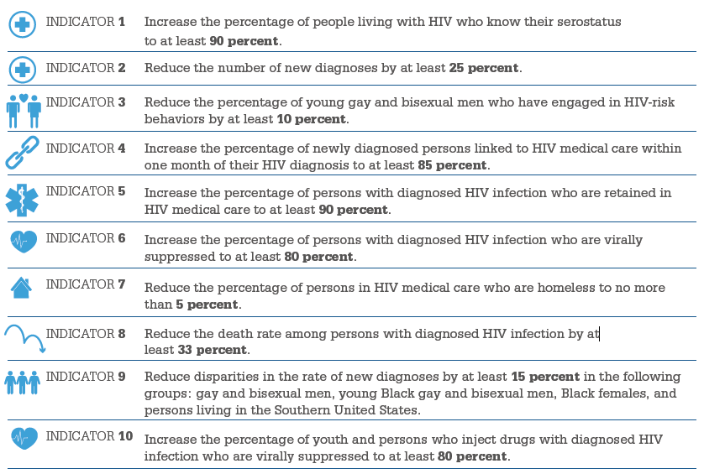
NHAS 2020 Indicators At-A-Glance
Notes:
Note: Dr. Cheever’s portion of the presentation will focus on relating the NHAS 2020 indictors to the RWHAP and outcomes shown through our data.
Equally important to our work on NHAS 2020, is the tracking of progress through data. You will hear this as a reoccurring theme throughout the duration of the conference as it is an overarching goal and part of our day-to-day mission.
NHAS 2020 indicators and RWHAP data particularly intersect with measure progress for,
Increased Viral Suppression – Indicator 6
Reduction in Homeless Population - Indicator 7
Reducing Health Disparities - Indicator 9 and
Assessing our efforts with Youth - Indicator 10
The next several slides I will delve into this some more with some specific client-level data the RWHAP is using to measure outcomes.

Slide 10
NHAS 2020 and the RWHAP

Slide 11
HIV/AIDS Bureau Vision and Mission
Vision
Optimal HIV/AIDS care and treatment for all.
Mission
Provide leadership and resources to assure access to and retention in high quality, integrated care, and treatment services for vulnerable people living with HIV/AIDS and their families.

Slide 12
Purpose of RWHAP
Public health approach to provide a comprehensive system of care
Ensure low-income people living with HIV (PLWH) receive optimal care and treatment
Notes:
Remember why this program exists. It is to provide high-quality HIV care and treatment services to low-income PLWH.
RWHAP has an important role to play in the public health response to HIV. Our clients achieve higher rates of viral suppression than PLWH receiving services elsewhere.
When a person is virally suppressed, they are far less likely to transmit HIV to others.

Slide 13
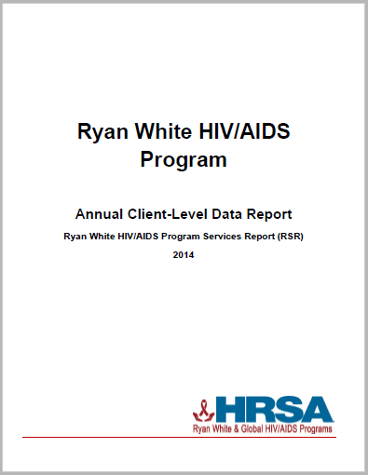
Using Client-level Data to Measure Outcomes
National focus on data
Program monitoring and evaluation
NHAS 2020
5 years of data available 2010-2014
Expands the availability of and access to Ryan White HIV/AIDS Program client-level information
First annual publication of national RWHAP client-level data collected through the RSR
EMA & TGA data reports look at all data within an EMA/TGA (Includes RWHAP Parts A-D funded recipients)
Notes:
Remember why this program exists. It is to provide high-quality HIV care and treatment services to low-income PLWH.
RWHAP has an important role to play in the public health response to HIV. Our clients achieve higher rates of viral suppression than PLWH receiving services elsewhere.
When a person is virally suppressed, they are far less likely to transmit HIV to others.

Slide 14
Viral Suppression Among RWHAP Clients, 2010-2014
Viral suppression: ≥ 1 OAMC visit during the calendar year and had ≥1 viral load reported whose last viral load was <200 copies/mL.
Source: HRSA, HAB, Annual Client-Level Data Report, Ryan White Services Report, 2014
Notes:
Rates of viral suppression are going up among clients who receive medical care in the RWHAP. There is still room for improvement but we’re going in the right direction…

Slide 15
Viral Suppression by Race/Ethnicity, RSR 2010-2014
Viral suppression: ≥ 1 OAMC visit during the calendar year and had ≥1 viral load reported whose last viral load was <200 copies/mL.
Source: HRSA, HIV/AIDS Bureau, Annual Client-Level Data Report, Ryan White Services Report, 2014
Notes:
Looking at the rates viral suppression by race/ethnicity…
The scale for viral suppression is from 60% to 90%
Viral suppression lowest in Blacks with Asians having the highest rates of suppression.

Slide 16
Viral Suppression by Age, RSR 2014
Viral suppression: ≥ 1 OAMC visit during the calendar year and had ≥1 viral load reported whose last viral load was <200 copies/mL.
Source: HRSA, HAB, Annual Client-Level Data Report, Ryan White Services Report, 2014
Notes:
There are disparities in outcomes, particularly in terms of age, in particular among young people. This is why HAB has been putting an increased focus on young people.
Lowest suppression rates among the 19-24 years olds (yellow line) followed by the 13-18 year olds (brown with dark blue blocks)
over the last 4 years of RSR data, biggest change in decreasing disparities is in the youth

Slide 17
Ryan White HIV/AIDS Program Clients (non-ADAP), by Housing Status, 2014—United States and 3 Territories
Notes:
In 2014, of the 481,745 RWHAP clients with reported housing status, 11.8% had temporary housing and 4.7% had unstable housing.

Slide 18
Ryan White HIV/AIDS Program Clients (non-ADAP), by Gender and Housing Status, 2014—United States and 3 Territories
Stable
Temporary
Unstable
Notes:
A greater proportion of female RWHAP clients had stable housing in 2014, compared with male and transgender RWHAP clients. Among female clients, 10.0% had temporary housing and 3.8% had unstable housing. Among male clients, 12.4% had temporary housing and 5.0% had unstable housing. Among transgender clients, 16.1% had temporary housing and 10.3% had unstable housing.

Slide 19
Viral Suppression among Young, Black/African American MSM (YBMSM) Aged 13–24 Years Served by the Ryan White HIV/AIDS Program (non-ADAP), 2014—United States and 3 Territories
≥5 percentage points lower than YBMSM overall
Note: N represents the total number of clients in the specific subpopulation.
Viral suppression: ≥ 1 outpatient ambulatory medical care visit during the calendar year and ≥1 viral load reported, with the last viral load result <200 copies/mL.

Slide 20
Interventions and Coordination Activities to Address NHAS 2020

Slide 21
HIV/AIDS Bureau Priorities
NHAS 2020/PEPFAR 3.0 - Maximize HRSA HAB expertise and resources to operationalize NHAS 2020 and PEPFAR 3.0
Leadership - Enhance and lead national and international HIV care and treatment through evidence-informed innovations, policy development, health workforce development, and program implementation
Partnerships - Enhance and develop strategic domestic and international partnerships internally and externally
Integration - Integrate HIV prevention, care, and treatment in an evolving healthcare environment
Data Utilization - Use data from program reporting systems, surveillance, modeling, and other programs, as well as results from evaluation and special projects efforts to target, prioritize, and improve policies, programs, and service delivery
Operations - Strengthen HAB administrative and programmatic processes through Bureau-wide knowledge management, innovation, and collaboration
Notes:
NHAS 2020/PEPFAR 3.0: Maximize HRSA HAB expertise and resources to operationalize NHAS 2020 and PEPFAR 3.0. This includes utilizing our RWHAP and PEPFAR legislations, resources, staff and recipient expertise, national leadership, and partnerships to achieve the goals of NHAS 2020 and PEPAR 3.0.
Examples of focus areas/activities:
• HRSA and HAB level PrEP Workgroups
• RWHAP Part A HIV Continuum of Care Learning Collaborative Initiative
• Global program work in health workforce development and health systems strengthening in the four Fragile States
• Continuous engagement of HAB staff expertise for the development and implementation of NHAS and PEPFAR activities
Leadership: Enhance and lead national and international HIV care and treatment through evidence-informed innovations, policy development, health workforce development, and program implementation.
Examples of focus areas/activities:
• Presenting at the USCA and other high profile meetings to disseminate HRSA policies, HIV care and treatment information and best practices
• Convening the Ryan White HIV/AIDS Program Consultation on Clinical Quality Measurement of Retention in HIV Medical Care
• Staff engagement with opportunities for leadership through workgroups, special projects, Cooperative Agreement and/or contract lead, etc. as well as HRSA leadership training
• Focusing on leadership development by and for people living with HIV
• Development of the National HIV Curriculum with the AETC National Resource and Coordination Center
• Dissemination of best practices through the SPNS Dissemination of Evidence Informed Interventions to Improve Health Outcomes along the HIV Care Continuum Initiative (DEII)
• Developing an HIV health care workforce strategy
• Resilient and Responsive Health Systems in fragile countries
Partnerships: Enhance and develop strategic domestic and international partnerships internally and externally. This includes promoting better collaboration across Divisions, Bureaus/Offices, and HHS OpDivs and other federal agencies in design and implementation of data utilization, programmatic initiatives, communications, and policy development to support service integration and to utilize HRSA, HAB, and partner resources most effectively.
Examples of focus areas/activities:
• Strategic partnerships development work focusing on CDC,SAMSHA, CMS, and HOPWA
• Internal HRSA strategic partnership work with BPHC on service delivery; BHW for workforce development; MCHB for adolescent health and maternal and child health
• Overall Hepatitis C focus and SMAIF Hepatitis C initiative working with BPHC, CDC, and OHAIDP
Integration: Integrate HIV prevention, care, and treatment in an evolving healthcare environment. This includes maximizing opportunities afforded by the healthcare system for preventing infections, increasing access to quality HIV care, and reducing HIV-related health disparities.
Examples of focus areas/activities:
• Quality Management Programs and Quality Measures in the RWHAP and Medicaid
• SPNS Health Information Technology
• Integrated HIV Prevention and Care Plans, including the Statewide Coordinated Statement of Need
• Leveraging opportunities offered by health delivery system reform
Data Utilization: Use data from program reporting systems, surveillance, modeling, and other programs, as well as results from evaluation and special projects efforts to target, prioritize, and improve policies, programs, and service delivery.
Examples of focus areas/activities:
• Continue to document outcomes of the RWHAP and delineate health disparities
• Provide technical assistance to grantees and staff to enhance their capacity
• Focus programmatic, cooperative agreements, and special study investment on specific population focus based on data, e.g. youth, black men who have sex with men, transgender individuals to improve health outcomes
• SPNS Health Information Technology investments
Operations: Strengthen HAB administrative and programmatic processes through Bureau-wide knowledge management, innovation, and collaboration. This includes supporting excellence in HIV care and treatment service delivery and programs by ensuring efficient business and scientific administration, implementing effective communication and policies, and enhancing the skills of current staff.
Examples of focus areas/activities:
• Streamline and improve the site visit, non-site visit, and conference planning processes for travel
• Enhancing communication mechanisms for external and internal stakeholder with an emphasis on staff communications
• Improving SharePoint functionality for workflow processes and information management
• Improving EHB functionality for workflow, dashboard utilization, and reports

Slide 22
HRSA: Special Initiatives
Jurisdictional Approach to Curing HCV among People of Color Living with HIV
Building Care and Prevention Capacity: Addressing the HIV Care Continuum in Southern Metropolitan Areas (NACCHO)
Leadership Training for People of Color Living with HIV
Improving Access to Care Using Community Health Workers to Improve Linkage and Retention in HIV Care
Increase Access to Health Care Coverage and Improve Health Literacy
Integrated HIV Planning
Consultation Meetings and Reports (Women, Youth, Trauma, PLWH Leadership, Retention Measure, Pediatric Care Expertise)
Notes:
SOUTHERN METRO
Funded under Secretary’s Minority AIDS Initiative Fu
The Southern U.S. bears a disproportionate burden of newly diagnosed cases of HIV and rates of infection
Minority populations continue to experience poor health outcomes
RWHAP Part A jurisdictions in the Southern U.S. face a wide range of challenges which impact their ability to fully implement the most effective clinical and behavioral programs to improve health outcomes for PLWH
Project will implement innovative models of service delivery to improve minority population health along the HIV care continuum
Focus on MSM, youth, cisgender and transgender women, and people who inject drugs (PWID)
Funding to National Association of County and City Health Officials (NACCHO), which will serve as the Coordination and TA Center for four subrecipients, to be selected from competitive pool (agencies from 18 RWHAP Part A jurisdictions—Florida, Georgia, Louisiana, North Carolina, Tennessee, Texas, and Virginia)
LEADERSHIP TRAINING FOR PEOPLE OF COLOR LIVING WITH HIV
Traing people of color living with HIV to participate in RWHAP planning bodies, medical and support care teams, boards of directors, and other mobilization efforts to address NHAS
Will also support leadership development for transgender women of color and support expansion of the capacity of HIV prevention and care delivery systems.
HRSA’s partnering with HHS Office of HIV/AIDS and Infectious Disease Policy, which was funded under the Secretary’s Minority AIDS Initiative Fund.
NMAC awarded cooperative agreement
COMMUNITY HEALTH WORKER
Best practices for engaging Community Health Workers in RWHAP Part C programs
Boston University’s Center for Advancing Health Policy
HEALTH COVERAGE AND HEALTH LITERACY
Enrollment in ACA coverage and health literacy of providers and clients
INTEGRATED HIV PLANNNING
Support RWHAP Part A and B recipients and their planning bodies to integrate across prevention and care service systems.
Support will also be provided for submissions for the CDC/HRSA Integrated HIV Prevention and Care Plan submissions.
The cooperative agreement went to JSI

Slide 23
HRSA: More Special Initiatives
HIV Care and Housing Coordination through Data Integration to Improve Health Outcomes along the HIV Care Continuum
Understanding barriers for improving health outcomes among youth
Evidence-informed and best practices interventions for engaging MSM of color
SPNS initiative on Engaging Transgendered Women of Color in HIV Care
Evidence-informed interventions: Jails, Buprenorphine, Outreach and Retention/Re-engagement
HIV continuum of care improvement learning collaborative among RWHAP Part A recipients
Notes:
DATA INTEGRATION
Partnership with HUD on data integration among HOPWA and RWHAP programs to improve client outcomes

Slide 24
NHAS 2020
Listening Session

Slide 25
Thank you!
Antigone Dempsey, MEd
Division Director, Division of Policy and Data
HIV/AIDS Bureau
adempsey@hrsa.gov

